Slide 1
Mentoring Program
Innovation Jam: Paulina Freidlin

Slide 2
Introduction
Challenge: Keeping up with rapid advancements in skills and knowledge is critical but challenging.
Short-Term Solutions: Quick troubleshooting or guidance works temporarily but lacks sustainability.
Current Gaps: Without a structured framework, mentoring efforts become inconsistent, leading to missed leadership opportunities and reduced support for developers.
Impact: A lack of structured growth pathways can lead to technological stagnation and higher turnover.

Slide 3
From Guidance to Mentoring Program
Challenge: Establishing a structured mentoring process without an existing educational plan.
Approach: An educational plan serves as a foundational step for structuring mentorship by outlining goals, strategies, and evaluation methods.
Customization Need: Creating an educational plan requires an individualized approach due to diverse team member experiences and knowledge levels.
Solution: The Mentoring Program provides a flexible framework that supports creating tailored educational plans while fostering both technical expertise and leadership development.

Slide 4
Mentoring Program Concept

Slide 5
Mentoring Program Goals
Enhanced Skill Development
Leadership Development
Improved Employee Retention
Fostering Innovation
Building a Learning Culture
Notes:
Enhanced Skill Development: Mentorship fosters a deeper understanding of technical skills and best practices, empowering employees to tackle complex challenges more effectively. By engaging in focused exercises or thoughtfully designed project tasks, mentees enhance their capabilities, contributing to the company’s success.
Leadership Development: By giving experienced developers opportunities to mentor others, organizations cultivate a pipeline of future leaders. This dual focus not only supports mentees but also allows mentors to refine their leadership skills, building a more capable and confident workforce.
Improved Employee Retention: A strong mentorship program signals that the organization values growth and well-being. By investing in employee development, companies can decrease turnover rates, as employees who feel supported are more likely to remain loyal and committed.
Fostering Innovation: Mentorship encourages a culture of collaboration and knowledge sharing, essential for innovation. Working together, mentors and mentees can generate new ideas and solutions, driving the company forward and enhancing its competitive edge.
Building a Learning Culture: Embedding mentorship into the company culture creates an environment where continuous learning is prioritized. This culture supports individual growth, encourages teams to embrace change, and adapt to new challenges, ultimately improving overall performance.

Slide 6
Mentoring Program Strategies
Define Roles: Mentor, Mentee, Managers, HR
Set Up the Program: Onboarding, orientation, and pairing/matching, Recurring check-ins and goal setting
Structured Plan Creation: Develop a curriculum, iteration plans, timeline, and review strategy
Collaborative Platform: Digital workspace, progress tracking, feedback loops, focus on soft skills
Mentor Support: Training, sync meetings, balancing responsibilities guidance
Recognize Achievements: Celebrate milestones and recognize mentor/mentee efforts

Slide 7
Mentoring Program Structure
The mentoring program aims to enhance skill development and leadership growth through iterative sessions and an individualized approach supported by mentors guidance.
This structure not only fosters mentee development but also strengthens mentors’ leadership skills, creating a culture of continuous learning and collaboration.

Slide 8
Mentoring Program Setup
Define Session Periods
Prepare Program Platform
Program Announcement
This introduction ensures everyone in the company is aware of the program, its schedule, and its purpose

Slide 9
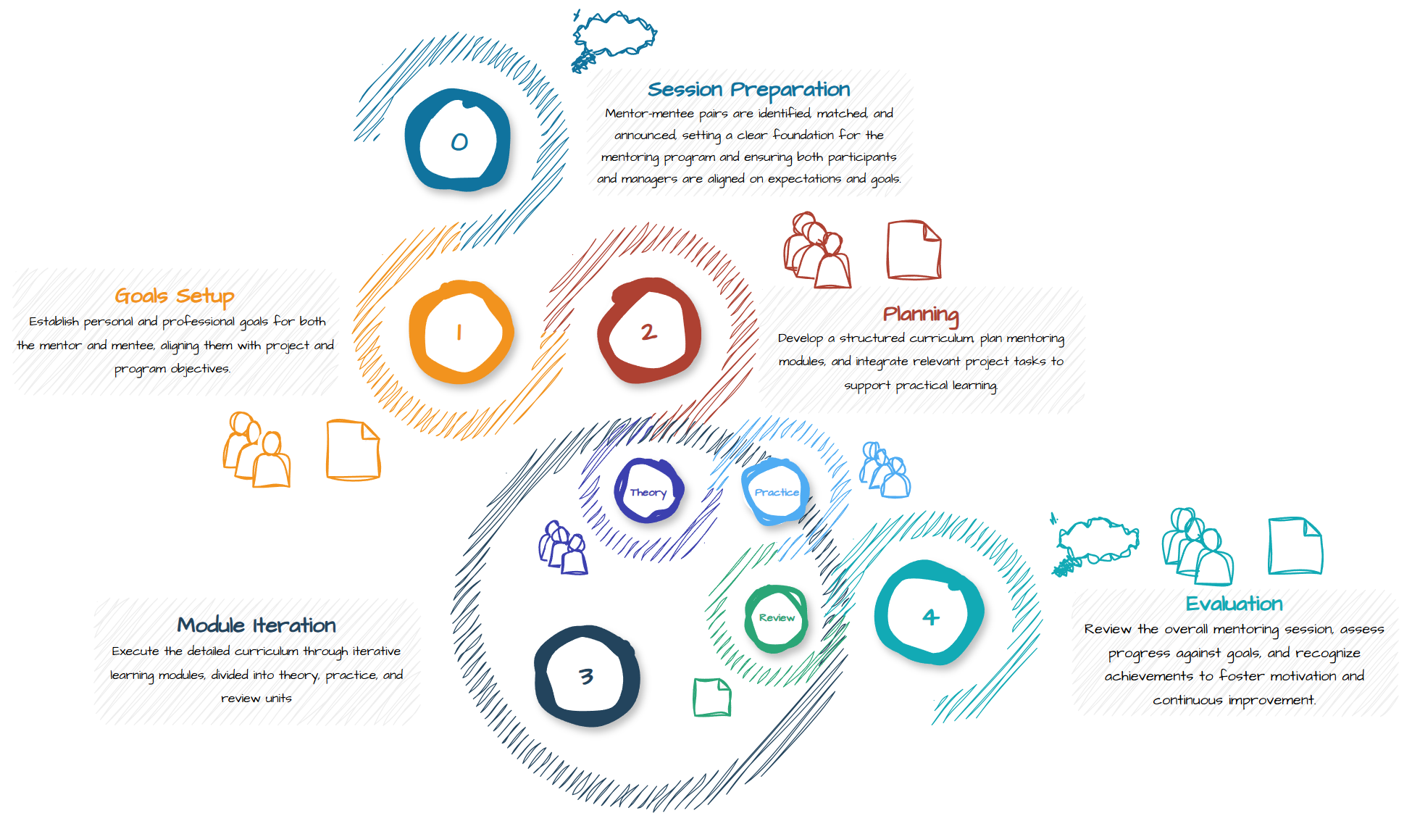
Mentoring Session Structure
Notes:
Introduction Phase:
Activities: Announcements, platform preparation, session timelines
Outcome: Clear communication about program details and objectives
Phase 0. Preparation:
Activities: Identify candidates, mentor-mentee matching, kickoff meetings
Outcome: Well-matched pairs ready to begin
Phase 1. Goals Setup:
Activities: Onboarding, goal alignment, initial meetings
Outcome: Documented individual and program goals
Phase 2. Planning:
Activities: Curriculum development, project integration, scheduling
Outcome: Detailed curriculum, timeline, and booked sessions
Phase 3. Module Iteration:
Activities: Theory discussions, practical exercises, progress check-ins, feedback
Outcome: Completed modules, documented achievements, next module plans
Phase 4. Evaluation:
Activities: Final feedback meetings, company-wide recognition
Outcome: Comprehensive feedback and recognition of achievements

Slide 10
Mentor Guide
The mentor guide is designed to equip mentors with the tools and strategies needed to effectively support mentees through structured, iterative sessions.

Slide 11
Curriculum Preparing
Mentee Interview based on goals document
Forming a Checklist of skills and topics to cover
Analyzing and sorting the checklist, identifying topics that might require iterative approach, combining into modules
Brief goals and expectations of modules with approach ideas
Identifying in-project tasks suitable for mentoring purposes

Slide 12
Educational Plan
Modules Goals
Theoretical Content
Practice Approaches
Feedback Expectations
Timeline and Meeting Schedule:
Theory discussion
Practice exercise requirements discussion
Execution and progress review checkpoints
Module review and feedback exchange

Slide 13
Mastering a Module
Review and prepare theory material
Pick a practical exercise:
In-project or extra
Type: design a system in existed codebase, code review and refactor, pair programming, skeleton-meat
Create/Review requirements, examine it for meeting module goals, set up Definition of Done
Prepare/Review codebase and content
Specify what to pay attention for during checkups
Identify learning objectives for mentor
Set up evaluation criterias

Slide 14
Mentoring Strategies
Balance Project and Mentoring: Manage priorities effectively
Structure and Flexibility: Adapt plans as needed
Two-Way Process: Emphasize growth for both mentor and mentee
Bonding and Feedback: Build trust and provide constructive feedback
Motivation and Challenges: Inspire mentees while pushing them to grow
Conflict Resolution: Address issues with empathy and soft skills

Slide 15
Mentoring Program strengthens individual growth and supports organization’s success.

Slide 16
Documents
https://drive.google.com/drive/folders/1lC_LRsk0rEbgF192VSHto4zmUKPtwj-z?usp=drive_link

